Slide 1

RETAIL DATA ANALYSIS
By Ramya P

Slide 2
Customers360
Custid
Customer_City
Customer_State
Gender
First_Tnx_Date
Last_Tnx_Date
Tenure
No_of_Transaction
Total_revenue
Profit
Discount
Total_Quantity
Items_Purchased
Total_Stores_purch

Slide 3
Orders360
Order_id
Total_Items
Total_Quantity
Amount
Total_Discount
items_with_discount
Total_cost
Total_Profit
Profit_Percentage
distinct_categories
weekend_trans_flag
Hours_flag

Slide 4
Store360
Store_ID
seller_city
seller_State
Region
Total_Store_Items_Sold
Total_Quantity_Store_Sold
Store_Total_Amount
Store_items_with_discount
Total_cost
Total_Profit
Profit_Percentage
distinct_categories
Weekend_Sales
Weekday_Sales
Average_order_value
Average_profit_per_tnx
Average_profit_per_customer
Average_customer_visits
Average_rating_per_customer

Slide 5
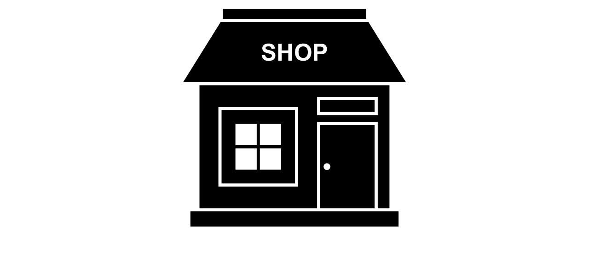


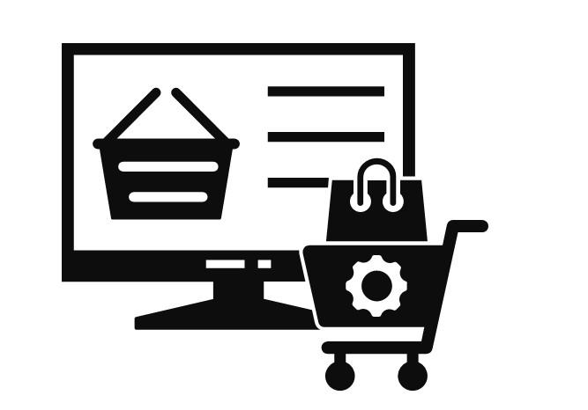
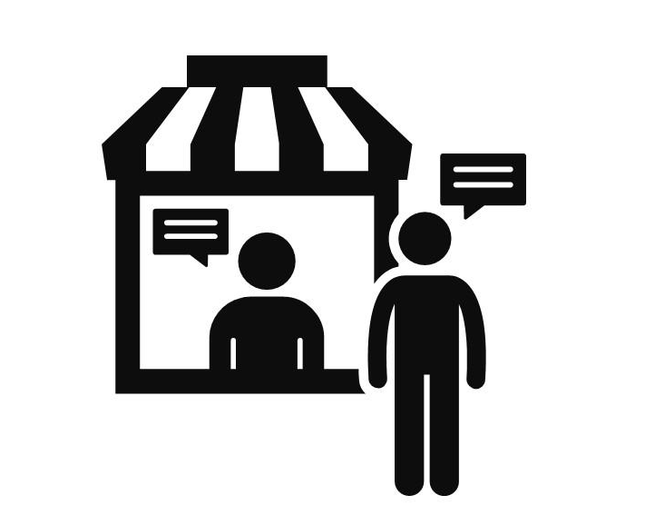
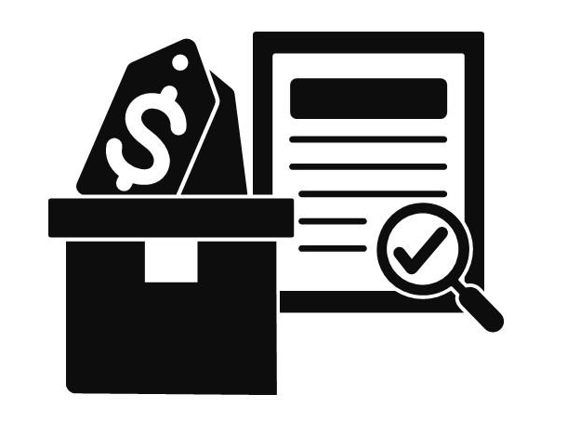
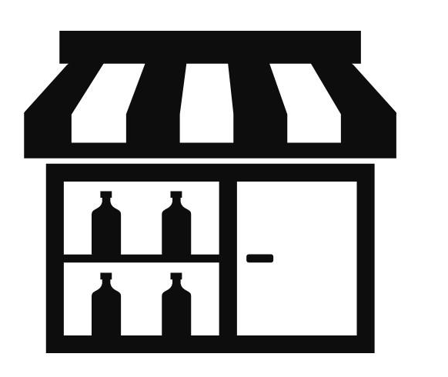
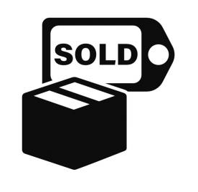
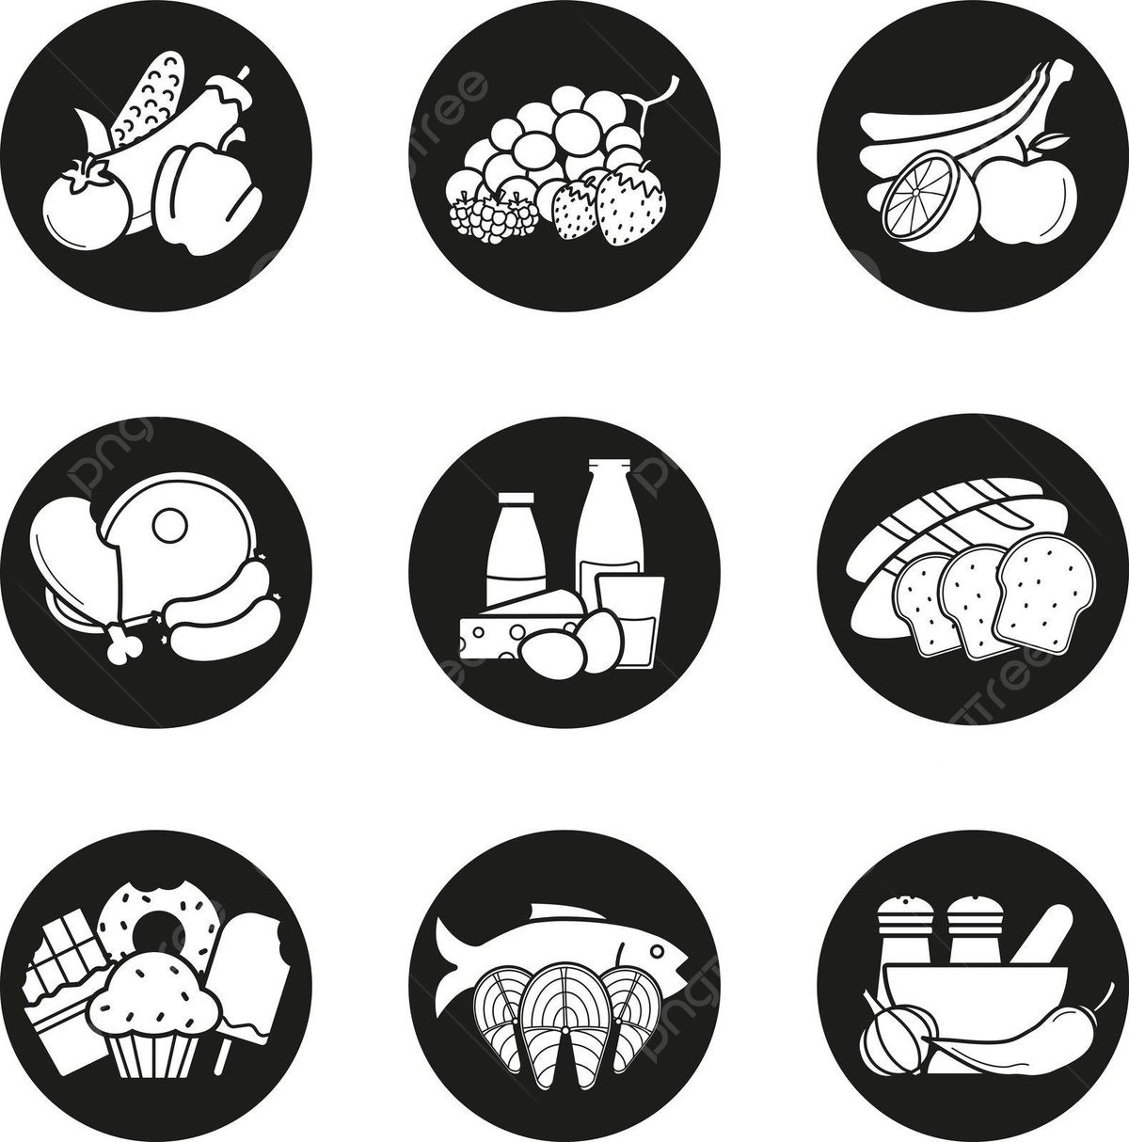

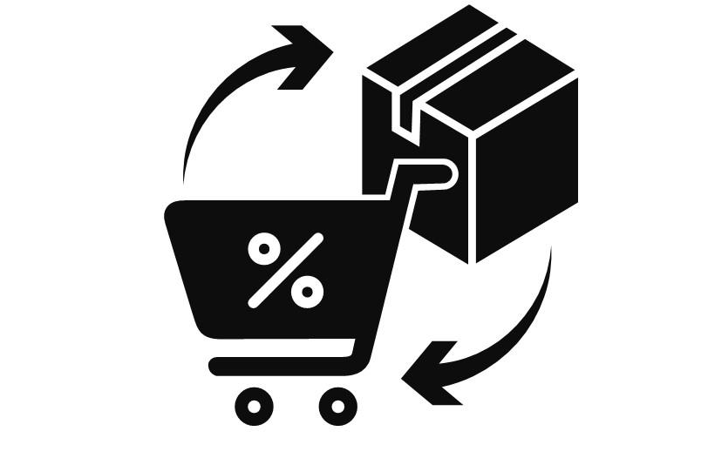
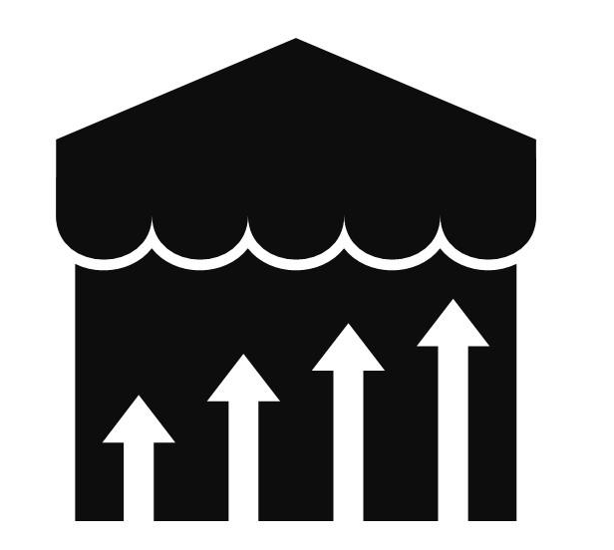
DATA OVERVIEW
BUSINESS PERFORMANCE OVERVIEW
Store Performance
A total of 37 stores are operating across 7 states, managing a customer base of approximately 96,803.
On average, each store serves around 2.6K customers, which helps assess regional demand and store workload.
Order Volume vs. Customer Behaviour
There were approximately 96K orders placed by 96K customers, indicating that most customers made only one purchase.
Strategic Recommendations: This tells us that repeat purchases are low, and there's a good chance to improve this by offering things like rewards or discounts to bring customers back.
Product Range and Sales
The business offers a wide range with 32K distinct products across 14 categories.
A total of 0.11 M units were sold, resulting in an average of 1.1 units per order, indicating that customers often buy in small quantities.
Revenue and Cost Analysis
Total Cost: 12.39 M
Total Amount Sold: 15.45 M
Total Profit: 2.18 M (17% of Total Cost)
Strategic Recommendations:This is a good profit margin, but it can be improved by reducing costs or adjusting pricing.
-> 37 Stores
-> 3 Channel
-> 7 States
-> 0.108 M Total Quantity
-> 96,803 Customers
-> 12.39 M Total Cost of Products
-> 31,752 K Products
-> 15.45 M Total Amount Sold
-> 14 Category
-> 0.49 M Total Discount
->96,894 Orders
-> 2.18 M Total Amount Profit

Slide 6
Customer Behaviour
Total Customers
Total Avg Transaction
Avg Customer Spend
INSIGHTS
96,803
1.00094
159.56272
Consistent Purchase Pattern
Each customer made 1 transaction on average, indicating a one-time buyer behavior.
Stable Spend & Transaction Value
The Avg. Spend per Customer is 159, which is nearly same as the Avg. Transaction Value confirming that customers made only one purchase on average.
Avg Profit
With an Avg. Profit of 22 per order, the business maintains a ~14.3% profit margin.
Strong Customer Satisfaction Score
A high Avg. Review score of 4.07 indicates positive customer experience.
Avg Transaction value
Avg profit
Average Review per Order
159.41286
22.55203
4.078789

Slide 7
Year-over-Year Business Performance Overview
Year-over-Year Growth Insights (2022 → 2023)
Customer Growth
Total customers increased from 42,693 to 53,830 , showing a YoY growth of 26%.
Order Volume
Total orders grew from 42,710 to 53,883, also, a 26% increase.
Product Expansion
Total products increased from 16,251 to 20,078, a 22% growth.
Profit Growth
Total profit increased from 0.93 M to 1.24 M showing a 32% YoY growth.
1
2
1
2
3
4
3
4

Slide 8
Year-over-Year Customer & Business Performance Overview
Year-over-year Growth Insights
(2022 → 2023)
YoY Total Average Transactions
Mirrors this exact trend (since each customer makes 1 transaction/year on average).
YoY Average Customer Spend
Average Customer Spend dropped from 184 in 2021 to 160 in 2022 and stayed stable in 2023.
YoY Average Profit
Average Profit per Transaction slightly decreased from 23 in 2021 to 22 in 2022 but slightly increased again to 23 in 2023.
YoY Average Review per Order
Average Review per Order increased from 3.71 in 2021 to 4.14 in 2022 and stayed stable in 2023.

Slide 9
Regional Store Performance Analysis
INSIGHTS BY REGION
West Region – Top Performer
Highest in all key metrics:
  Avg Customers/Orders: ~3.5 K
  Avg Quantity: 3,936
  Avg Profit: 77,442
South Region
Second-highest in all metrics:
  Avg Customers: 2.9 K
  Avg Quantity: 3,357
  Avg Profit: ₹65,581
East Region – Moderate Performance
Avg Customers & Orders: 1.8 K
Avg Profit: ₹55,310
North Region – Lowest Across Metrics
Avg Customers: 1.2 K
Avg Quantity: 1,386
Avg Profit: ₹31,992

Slide 10
Regional Customer Behaviour
OVERVIEW BY REGION
1. Highest Spend – North
North customers spend the most per transaction (206), making them your top-value region.
2. Highest Profit – East
East region delivers the highest Avg. Profit per order (30), despite having the lowest spend (₹142).
3. Highest Customer Base – South
South has the largest customer base by far (74,788 customers, ~70% of total).
4. Best Customer Satisfaction – East
East leads with a 4.17 average review score, followed closely by South.

Slide 11
Weekday vs Weekend Sales Performance (1/2)
INSIGHTS:
Customer Distribution:
  Majority of the customers shop on weekdays (76,986 ) compared to weekends (20,418 ).
Order Volume:
  A similar trend in orders placed, with 76,996 orders on weekdays and 20,419 on weekends.
Revenue Generation:
  Weekday revenue is significantly higher:
  12 M vs 3 M on weekends.
  Profit Analysis:
  Profit on weekdays: 1.73 M is much higher than 0.45 M on weekends.

Slide 12
Weekday vs Weekend Sales Performance (2/2)
INSIGHTS:
Total Transactions:
  Weekdays account for a significantly higher number of transactions (76,996) compared to weekends (20,419).
Average Transactions:
  The average transaction per order is almost identical across both periods:
    Weekday: 42.00156
    Weekend: 42.00037

Slide 13
RECOMMENDATIONS:
1. Weekend-Only Promotions
Exclusive Discounts: Offer limited-time discounts only valid on weekends.
BOGO Deals: "Buy one, get one free" or similar offers can increase volume.
2. Loyalty Incentives
Double Points on Weekends: Reward loyal customers with extra points for weekend purchases.
Weekend Challenges: Offer a reward (e.g., free item, discount) for visiting or ordering on both Saturday and Sunday.
3. Targeted Marketing Campaigns
SMS/Email Reminders: Send weekend-specific offers to your customer base.
Social Media Ads: Promote weekend specials using geo-targeting and interest filters.
4. Themed Weekend Events
Live Music, Games, or Themes: Create a reason to visit beyond just the food/product.
Examples: "Sunday Brunch Vibes", "Saturday Game Night", "Family Fun Weekend".
5. Weekend-Only Delivery Perks
Free Delivery or Reduced Fees: Incentivize online orders with delivery discounts on weekends.

Slide 14
Channel-wise Performance Analysis – Weekday Vs Weekend
INSIGHTS:
Customer and Order Distribution:
In-store channel dominates with the highest number of customers and orders across both weekdays (67K+) and weekends (17K+).
Revenue Analysis:
In-store sales on weekdays generate the highest revenue at 10.7 M, followed by Phone Delivery on weekdays at 1.30 M .
Profit Contribution:
In-store weekday operations bring the highest profit (1.51 M), followed by Phone Delivery weekday (0.18 M).
Channel Comparison:
Phone Delivery performs better than Online in both revenue and profit, suggesting higher order values or better margins.

Slide 15
RECOMMENDATIONS:
Instore
Weekend Special Offers: Give discounts only on Saturday & Sunday.
Family Deals: Offer combo meals or discounts for groups.
Fun Events: Add live music, games, or lucky draws to attract more people.
Phone Delivery
Free Delivery on Weekends: Remove delivery charges to get more orders.
Call & Win: Random weekend orders win a free item or discount.
Online Orders
Online-Only Discounts: Give special offers only for online orders on weekends.
Simple Ordering: Make sure your website or app is easy to use.
Promote Online Deals: Share weekend deals on WhatsApp, social media, and email.

Slide 16
Channel Performance Analysis
INSIGHTS:
1. Instore Channel Dominates
Revenue: ₹1,43,42,453 (Highest among all)
Profit: ₹20,56,160 (Also the highest)
This channel is the most significant contributor to both revenue and profit, suggesting it’s the most effective and possibly mature channel.
2. Phone Delivery is the Second Strongest
Revenue: ₹17,22,160
Profit: ₹2,49,466
Though far behind instore, phone delivery generates a decent chunk of revenue and profit, indicating its potential as a support or growth channel.
3. Online Channel is Least Effective
Revenue: ₹2,87,866
Profit: ₹37,705
Both revenue and profit are minimal, pointing to either underutilization, poor digital presence, or inefficiencies in the online channel.
4. Profitability Trend
All three channels are profitable (positive profit values).
Profit Margins (approximate):
  Instore: ~14.3%
  Phone Delivery: ~14.5%
  Online: ~1.3%
While phone delivery has a slightly better margin than instore, the revenue base is much smaller.

Slide 17
Category-wise Revenue & Profit Comparison – Weekday vs Weekend
INSIGHTS:
High Revenue vs Profit:
Toys & Gifts has the highest revenue but is not the highest in profit, possibly due to lower margins or higher discounts.
Home Appliances, while second in revenue, is the most profitable.
Top Performing Categories:
Toys & Gifts leads in revenue during weekdays, but Home Appliances takes the lead in weekday profits.

Slide 18
Category-wise Revenue and Profit Performance Overview
INSIGHTS:
Top Revenue Generators:
  Toys & Gifts, Baby, and Home Appliances are the leading categories in terms of revenue, indicating high customer demand and sales volume.
Top Profit Contributors:
  Home Appliances is the most profitable category, despite being 3rd in revenue.

Slide 19
Store-wise Performance Analysis (1/2)

Slide 20
Store-wise Performance Analysis (2/2)
StoreID | Seller_City | Seller_state
ST103 | Akkarampalle | Andhra Pradesh
ST143 | Tarsali | Gujarat
ST106 | Anakapalle | Andhra Pradesh
ST132 | Bheemavaram | Andhra Pradesh
ST118 | Anantapur | Andhra Pradesh
ST167 | Chirala | Andhra Pradesh
ST186 | Siddipet | Andhra Pradesh
ST102 | Badepalle | Andhra Pradesh
ST125 | Bestavaripeta | Andhra Pradesh
ST218 | Kallur | Andhra Pradesh
INSIGHTS:
Review (ST103)
Top Review Ratings:
ST103, the highest performing store in revenue and profit, also maintains a high review score of 4.074, showing strong customer satisfaction.
4.074765
Geographic Concentration:
Out of the top reviewed stores, 9 out of 10 are located in Andhra Pradesh, showing a regional concentration of high-performing stores.

Slide 21
Monthly Revenue Trends Analysis
INSIGHTS:
Overall Growth Pattern
Revenue shows a strong upward trend from January 2022 (₹0.09M) to August 2023 (₹1.23M).
Seasonal Trends & Spikes
Highest revenue was in August 2023 (₹1.23M) and May 2023 (₹1.22M).
Other peaks include March 2023 (₹1.19M) and November 2022 (₹1.02M).
These could reflect successful marketing campaigns, seasonal demand, or product launches.
Declines or Dips
A sharp decline in September 2023 (₹0.02M) indicates either incomplete data, a reporting delay, or a serious performance drop.
Smaller declines are observed in:
  December 2022 to February 2023
  June–July 2023, with values slightly below ₹1M

Slide 22
Monthly Revenue and Customer Growth Trend

Slide 23
State-wise Revenue Performance (Top & Bottom 5)
INSIGHTS
Andhra Pradesh Leads Significantly:
With ₹11.55M, Andhra Pradesh generates the highest revenue, far surpassing other states.
It contributes the majority share among the top 5.
Big Drop from 1st to 2nd:
Gujarat, the second highest, only earns ₹1.63M, showing a large revenue gap after Andhra Pradesh.
Other top states (Chhattisgarh, Madhya Pradesh, Delhi) also fall well below ₹1M.
Weak Revenue Zones:
States like West Bengal (₹2.60K), Haryana (₹3.71K), and Delhi (₹4.31K) show very low performance in the bottom 5 chart.

Slide 24
Regional Popularity of Product Categories (in Millions)

Slide 25
INSIGHTS
South Region Dominates Sales:
The South leads significantly, especially with Toys & Gifts at 2.04M, the highest category-sales across all regions.
Other strong categories in the South include Food & Beverages, Home Appliances, and Luggage & Accessories, each above 1M.
West Region Focused on Baby Products:
The Baby category dominates in the West with 0.62M, followed by Toys & Gifts and Computers & Accessories, but none exceed 1M.
North Region Shows Balanced Distribution:
The North has moderate sales across several categories, with Luggage & Accessories leading at 0.32M.
Other notable categories include Home Appliances, Toys & Gifts, and Food & Beverages, all around the 0.2–0.3M mark.
East Region Has Lowest Sales:
The East shows the least activity, with all categories under 0.1M.
Home Appliances and Computers & Accessories are the top categories, though still minimal.

Slide 26
TOP AND BOTTOM PERFORMING STORES IN TERMS OF REVENUE AND PROFIT
Metric | ST103 (TOP) | ST354 (BOTTOM)
Revenue | 3.30M | 0.15M
Profit | 0.49M | 0.02M
Customers | 24,952 | 559
Profit Margin | 14.8% | 13.3%
Revenue/Customer | ~132.3 | ~268.3
BUSINESS INSIGHTS
1. Top vs Bottom Performance
TOP (StoreID: ST103) is outperforming with:
  Revenue: $3.30M
  Profit: $0.49M
BOTTOM (StoreID: ST354) has:
  Revenue: $0.15M
  Profit: $0.02M
2. Revenue Comparison
ST103 generates 22× more revenue than ST354.
3. Profit Comparison
ST103 earns 24.5× more profit than ST354.
4. Profit Margin (Profit ÷ Revenue)
ST103: (0.49 / 3.30) × 100 ≈ 14.8%
ST354: (0.02 / 0.15) × 100 ≈ 13.3%
Recommendations for ST354
Local Advertising: Use geo-targeted online ads and local influencers to raise awareness.
Referral Program: Reward existing customers for bringing in new ones.
Seasonal Campaigns: Run limited-time offers or events to draw attention.

Slide 27
TOP AND BOTTOM PRODUCTS BY REVENUE AND PROFIT
Type | Product | Revenue | Profit
Top | bb50f2e236e5eea0100680137654686c | 66,907.81 | 3,682.81
Bottom | 46fce52cef5caa7cc225a5531c946c8b | 9.59 | 7.39
BUSINESS INSIGHTS
1. Based on Revenue (First Table):
Top Revenue Product:
  ID: bb50f2e236e5eea0100680137654686c
  Revenue: 66,907.81
  Profit: 3,682.81
Bottom Revenue Product:
  ID: 46fce52cef5caa7cc225a5531c946c8b
  Revenue: 9.59
  Profit: 7.39
Type | Product | Profit | Revenue
Top | d1c427060a0f73f6b889a5c7c61f2ac4 | 14,325.10 | 62,140.55
Bottom | 34dfc6386b7550503bd2e582ef45d041 | 0.059 | 173.059
2. Based on Profit (Second Table):
Top Profit Product:
  ID: d1c427060a0f73f6b889a5c7c61f2ac4
  Profit: 14,325.10
  Revenue: 62,140.55
Bottom Profit Product:
  ID: 34dfc6386b7550503bd2e582ef45d041
  Profit: 0.059
  Revenue: 173.059

Slide 28
Gender Based Overview (1/2)
INSIGHTS:
Customer Demographics:
Female Customers (F): 67,608
Male Customers (M): 29,195
Female customers make up over 70% of the total customer base.
Order Distribution:
Orders by Females: 67,679
Orders by Males: 29,212
Order pattern closely mirrors customer count.
Average Customer Spend:
Females: 159.76
Males: 159.1
Total Customer Spend:
Females: 10.80 M
Males: 4.65 M

Slide 29
Gender Based Overview (2/2)
INSIGHTS:
Total Profit Contribution:
Females (F): 1.53 M
Males (M): 0.65 M
Female customers contribute to ~70% of total profit.
Average Profit Per Customer:
Females: 23.67
Males: 23.29
The average profit per customer is almost identical across genders.

Slide 30
Recommendations
Enhance Female-Focused Campaigns
Female customers dominate both spending and profit share (~70%).
Recommendation :
  Launch personalized email/SMS campaigns around women-centric themes or products.
  Offer exclusive discounts or early access for top female buyers.
  Use female customer data to refine product offerings and design.
Grow Male Customer Base
Males have similar profit potential per customer but are underrepresented.
Recommendation :
  Target male segments through platforms where they are more active (e.g., YouTube, Instagram, sports sites).
  Bundle or cross-sell products often bought by female customers as gifts for men.

Slide 31
Customer Behaviour
Total Orders | Type of Customers | Total Customers | Profit
1 | One Time Buyer | 96,767 | 21,80,367.87
2 | Repeat Buyers | 22 | 994.94
3 | Repeat Buyers | 7 | 435.44
4 | Repeat Buyers | 1 | 78.10
8 | Repeat Buyers | 1 | 185.63
9 | Repeat Buyers | 2 | 349.94
10 | Repeat Buyers | 1 | 236.79
11 | Repeat Buyers | 2 | 455.65
Type of Buyers | Total Customers | Total Profit
One Time Buyer | 96,767 | 21,80,367.87
Repeat Buyers | 36 | 2,736.49
INSIGHTS:
Dominance of One-Time Buyers
Number of Customers:
One-time buyers account for 96,767 customers, while repeat buyers are just 36.
Customer Base Share:
Repeat buyers make up only 0.037% of the total customer base (36 out of 96,803).
Loyalty & Retention Program
Repeat buyers (regardless of gender) have higher profit per customer than one-time buyers.
Recommendation:
  Launch a rewards program to encourage second purchases (e.g., points, coupons).
  Offer referral bonuses especially targeting frequent female customers to bring in others.
Profit Contribution
One-Time Buyers:
Contribute ₹21,80,367.87 in profit.
Repeat Buyers:
Contribute just ₹2,736.49 in profit.
Profit Share:
Repeat buyers contribute only about 0.13% of the total profit, despite multiple purchases.

Slide 32
RFM Segmentation
RFM Score | Segment Name | Description
11–12 | Premium | Best customers — very recent, frequent, and high-spending.
9–10 | Gold | Strong customers — recent, frequent, and good spending.
7-8 | Silver | Moderate value customers — active, but not top-tier in all metrics.
3–6 | Standard | Needs attention — less recent, lower frequency or spending; room to improve.

Slide 33

THANK YOU

